Slide 1
Internet of Things (IoT) Messaging Architecture
Date: 10 – 02 - 2021

Slide 2
Internet of Things (IoT) Messaging Architecture
Now we are discuss how the packet transfer from IoT Plane to IoT Gateway.
Initially there are 4 main componets.They are
            IOT Node
            IOT Gateway
            Mqtt Broker (VerneMQ)
            Payment Gateway

Slide 3
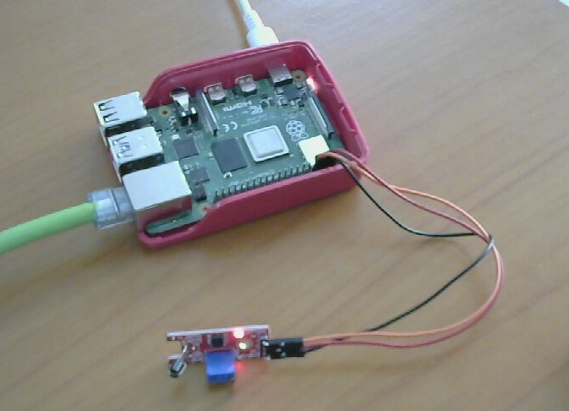
Internet of Things (IoT) Messaging Architecture
The sensor connected to RaspberryPi with a Touch sensor

Slide 4
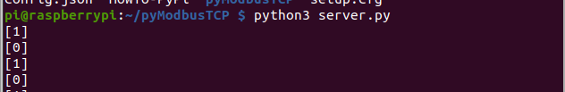
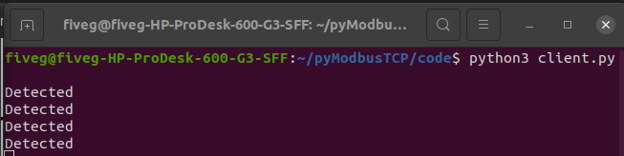
Internet of Things (IoT) Messaging Architecture
When touch the sensor find the conductivity and it will place the register using server.
There is any change touch detected the flag will be true (1).

Slide 5
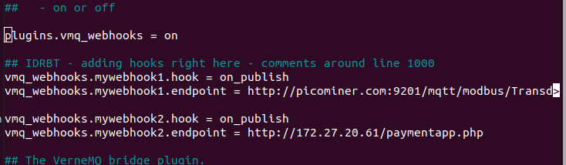
Internet of Things (IoT) Messaging Architecture
Gateway get True value it will be generate a packet and it is transferred to the Mqtt broker (VerneMQ). The Mqtt broker transferred to Payment gateway through Webhook.

Slide 6
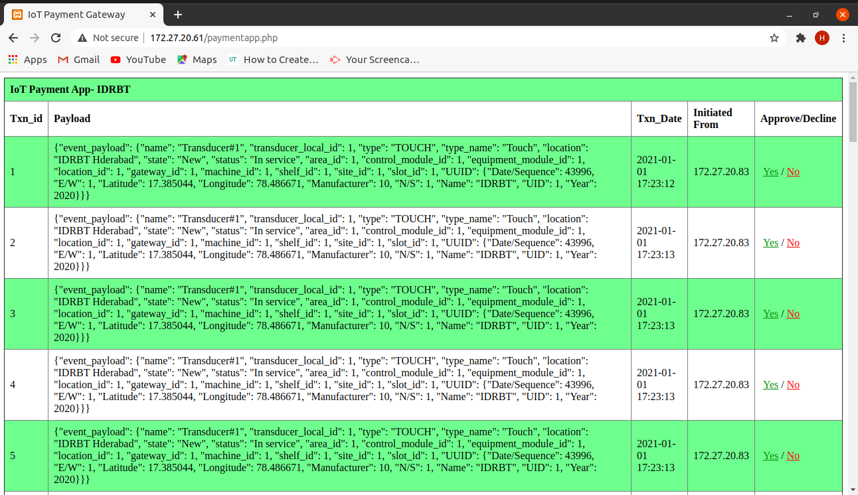
Internet of Things (IoT) Messaging Architecture

Slide 7
Internet of Things (IoT) Messaging Architecture
{
"event_payload": {
"name" : "Transducer#1",
"transducer_local_id": 1,
"type": "TOUCH",
"type_name": "Touch",
"location": "IDRBT Hderabad",
"state": "New",
"status": "In service","area_id": 1,
"control_module_id": 1,
"equipment_module_id": 1,
"location_id": 1,
"gateway_id": 1,
"machine_id": 1,
"shelf_id": 1,
"site_id": 1,
"slot_id": 1,
"UUID": {
"Date/Sequence": 43996,
"E/W": 1,
"Latitude": 17.385044,
"Longitude": 78.486671,
"Manufacturer": 10,
"N/S": 1,
"Name": "IDRBT",
"UID": 1,
"Year": 2020
}
}
}
Packet.json

Slide 8
Internet of Things (IoT) Messaging Architecture
Thank You

